Slide 1
Distributed Training of Deep Neural Networks
Prof. Assaf Schuster
Computer Science Department
Technion – Israel Institute of Technology

Slide 2
Motivation

Slide 3
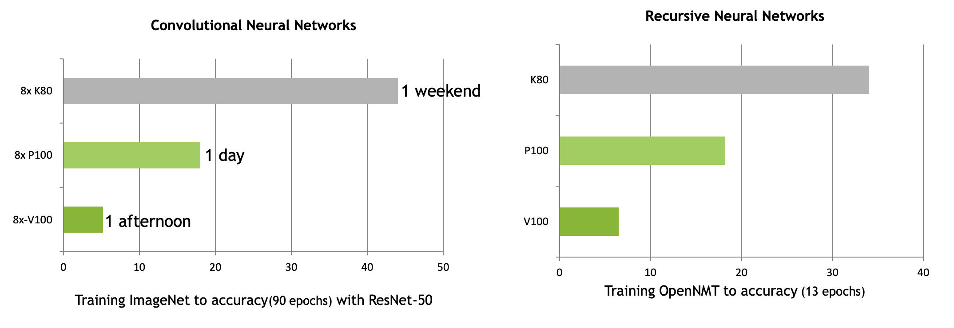
GPUS are getting faster
source: Nvidia

Slide 4
Why HPC? Why distributed?
Computational complexity of training neural networks is exploding.
Notes:
Explain importance.
Training SotA models requires insane amounts of computational power.
To reduce the computations we would like to split the computations across multiple devices.

Slide 5
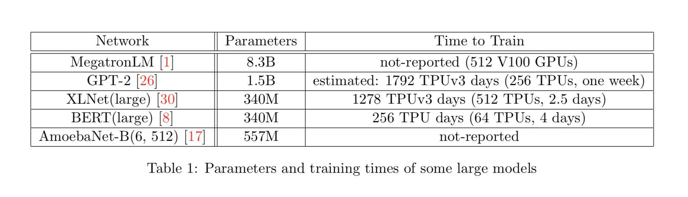
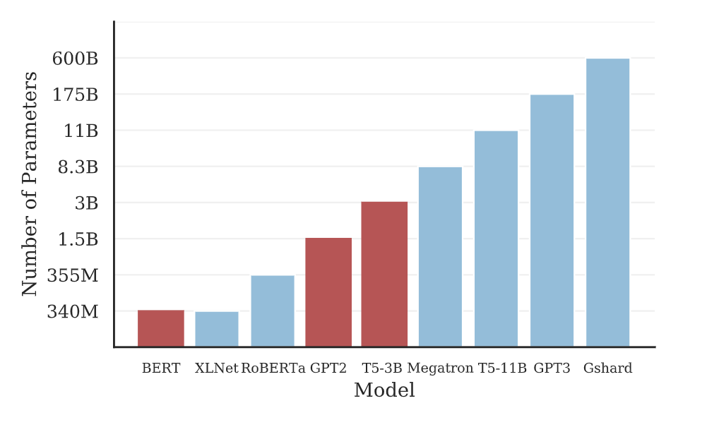
More Recently…

Slide 6
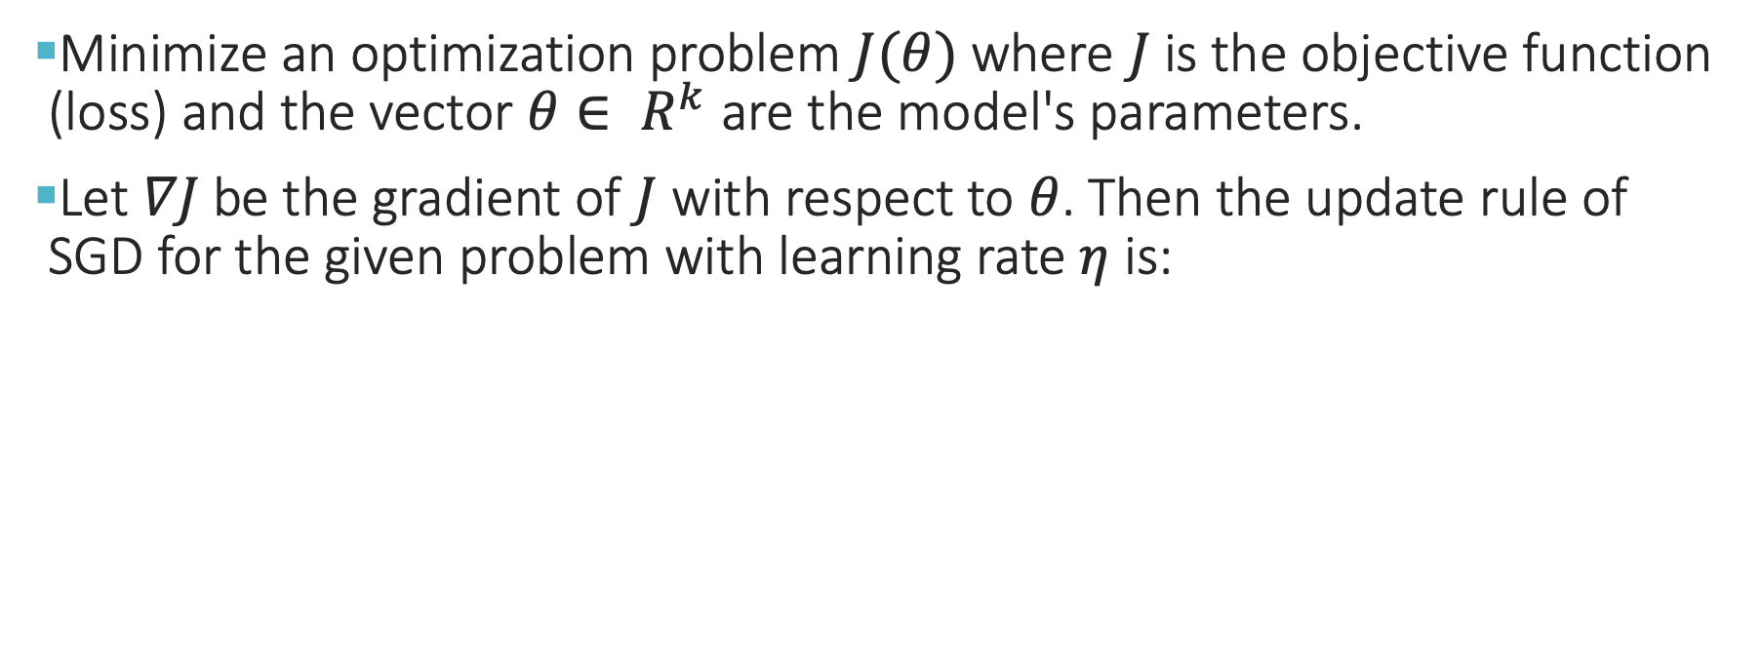
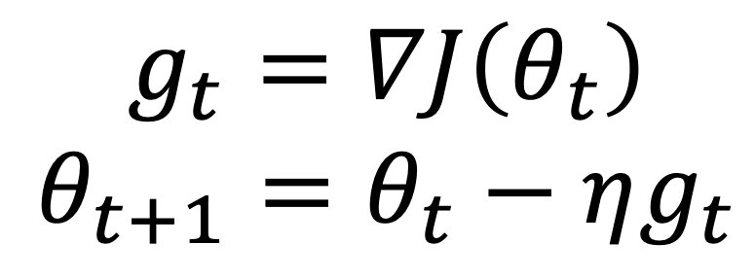
Stochastic Gradient Descent (SGD)
Minimize an optimization problem $J(θ)$ where $J$ is the objective function (loss) and the vector $θ∈ R^{k}$ are the model's parameters.
Let $∇J$be the gradient of $J$ with respect to $θ$. Then the update rule of SGD for the given problem with learning rate $η$ is:
Parallelize
$$g_{t}=∇J\left(θ_{t}\right)$$
$$θ_{t+1}=θ_{t}−ηg_{t}$$
Serial!
Notes:
Notice the serial nature of the process.
This motivates data parallelism at every point where the gradient is computed

Slide 7
Problem Decomposition

Slide 8
Domain decomposition
The data is partitioned across tasks and each task only works on its portion of the data.
SPMD (single program, multiple data)

Slide 9
Functional decomposition
The focus is on partitioning the computations rather than the data. The problem itself is decomposed and each task performs a portion of the overall work.
Typically used when pieces of data require different processing times

Slide 10
A Neural Network

Slide 11
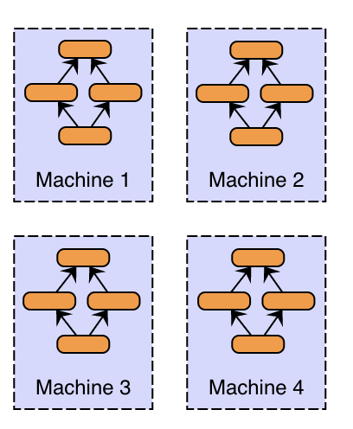
Domain decomposition (Data parallelism)
This strategy is straightforward; partition the work of the batch across different machines.
Different machines have a complete copy of the model.
Each machine simply gets a different portion of the batch, and results from each are combined.
source: skymind

Slide 12
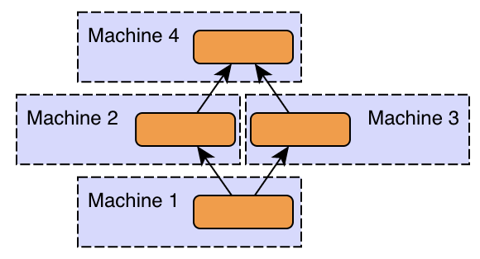
Functional decomposition (Model parallelism)
This strategy divides the work according to the neurons in each layer.
Different machines in the distributed system are responsible for the computations in different parts of a single network.
For example, each layer in the neural network may be assigned to a different machine.
source: skymind

Slide 13
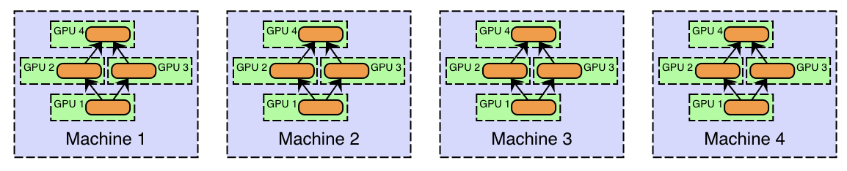
Hybrid decomposition
Both Model and Functional decomposition have issues and restrictions
The combination of multiple parallelism schemes can overcome the drawbacks of each scheme.
source: skymind

Slide 14
Domain Decomposition

Slide 15
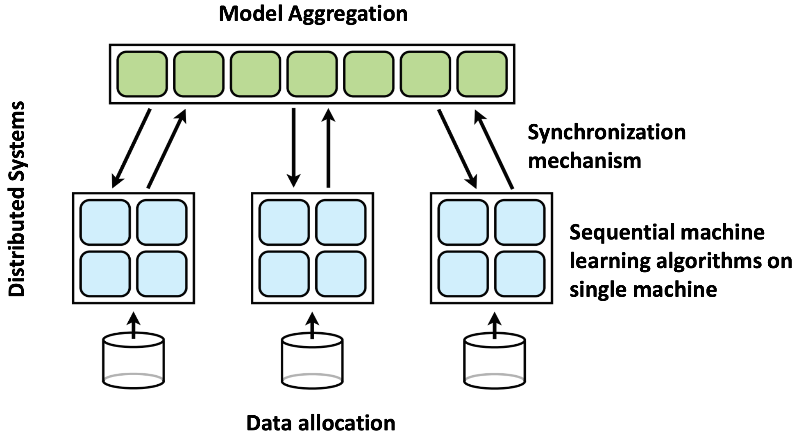
Distributed Training
Parameter Server
Batch
Workers

Slide 16
Most popular - Synchronous Training (SSGD)

Slide 17
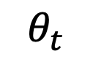
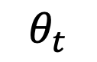
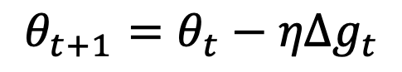
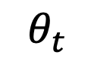
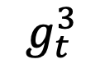
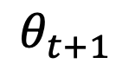
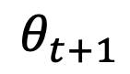
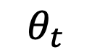
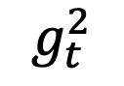
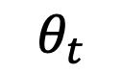
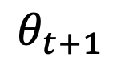
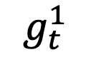
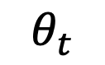
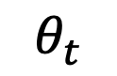
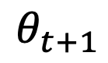
Synchronous SGD (SSGD)
$$θ_{t+1}=θ_{t}−ηΔg_{t}$$
$$θ_{t}$$
Parameter Server
$$θ_{t+1}$$
$$g_{t}^{2}$$
$$g_{t}^{3}$$
$$g_{t}^{1}$$
$$θ_{t+1}$$
$$θ_{t}$$
$$θ_{t}$$
$$θ_{t}$$
$$θ_{t+1}$$
$$θ_{t+1}$$
Model
Model
Model
$$θ_{t}$$
$$θ_{t}$$
$$θ_{t}$$
Data
Data
Data
Notes:
Scaling the performance of data parallelism requires increasing the “effective batch size”.
The increased batch size can result in a decrease of the model’s final accuracy.

Slide 18
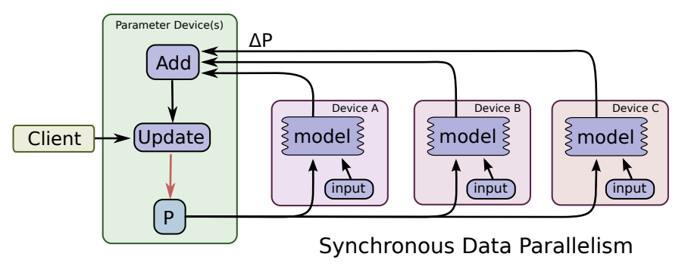
Synchronous scheme
source: “TensorFlow: Large-Scale Machine Learning on Heterogeneous Distributed Systems”

Slide 19
Sharding
If one parameter server is used, it will likely become a networking or computational bottleneck.

Slide 20
SSGD with no parameter server: peer-to-peer AllReduce

Slide 21
AllReduce
source: https://preferredresearch.jp/2018/07/10/technologies-behind-distributed-deep-learning-allreduce/
Notes:
Each process holds part of the gradients and we would like to have the sum in all of them

Slide 22
Ring-AllReduce
source: http://andrew.gibiansky.com/

Slide 23
Ring-AllReduce
source: http://andrew.gibiansky.com/

Slide 24
Ring-AllReduce
Synchronous Training
source: http://andrew.gibiansky.com/

Slide 25
Ring-AllReduce
source: http://andrew.gibiansky.com/

Slide 26
Ring-AllReduce
source: http://andrew.gibiansky.com/

Slide 27
Ring-AllReduce
source: http://andrew.gibiansky.com/

Slide 28
Ring-AllReduce
source: http://andrew.gibiansky.com/

Slide 29
Ring-AllReduce
source: http://andrew.gibiansky.com/

Slide 30
Ring-AllReduce
source: http://andrew.gibiansky.com/

Slide 31
Ring-AllReduce
source: http://andrew.gibiansky.com/

Slide 32
Ring-AllReduce
source: http://andrew.gibiansky.com/
Notes:
Notice the topology – gpu0 only talks about gpu1 etc., so connecting the gpu is easy
Recently nvidia combined this with a tree hierarchy
Ring allreduce is scalable up to 40 GPUs

Slide 33
Ring-AllReduce Example
source: https://eng.uber.com/horovod/

Slide 34
Speed-up
source: http://andrew.gibiansky.com/

Slide 35
Speed-up
source: https://eng.uber.com/horovod/
Notes:
Horovod is popular baseline. Works with ring allreduce
Dist tensorflow used to not be with ring allreduce so – you see is not scalable. Nowadays, dist tensorflow moved to ringallreduce (using nccl package of nvidia, pronounced “nickel”)

Slide 36
Issues with SSGD

Slide 37
SSGD and Batch Size
Partition the work of the batch across different workers into mini-batches.
Each worker gets a different portion of the batch; results are combined by the parameter server.
Observation:
Batch size = sum of all mini-batches on all workers
accelerators imply a lower-bound on mini-batch size
➔a linear growth of the batch size
Training with large batches damages final accuracy ➔ A scalability issue
Notes:
domain decomposition
Different machines hold a complete copy of the model.
Each machine simply gets a different portion of the batch, and results from each are combined.
Scaling the performance of data parallelism requires increasing the “effective batch size”.

Slide 38
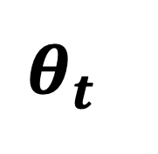
Training with large batches is bad for your health. More importantly, it's bad for your test error. Friends don't let friends use batches larger than 32.
~Yann LeCun
Multiple Small Batches – better exploration
$$θ_{t}$$
Large Batch

Slide 39
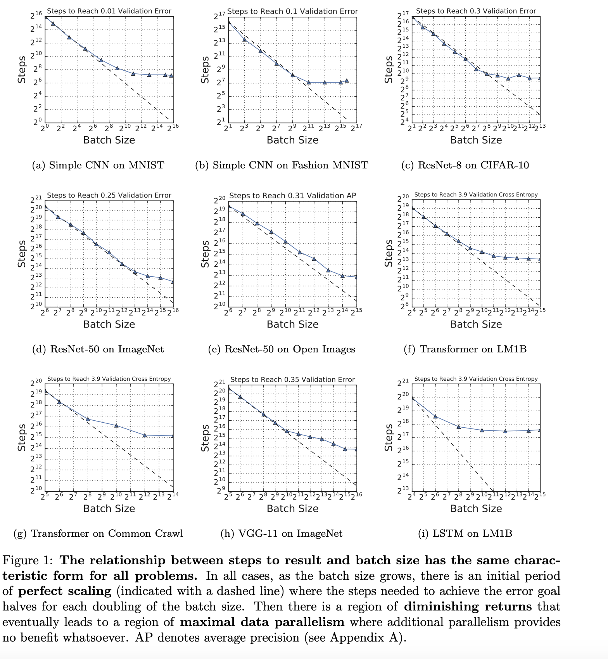
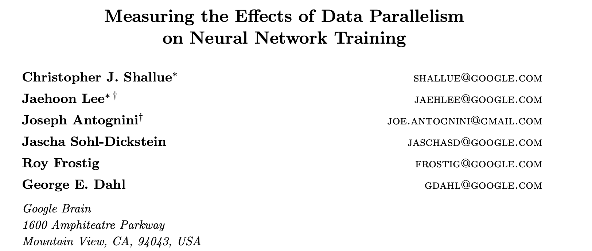
Scalability and Batch Size
2019
SSGD Problem I:
HUGE batches impose
an upper bound on scalability

Slide 40
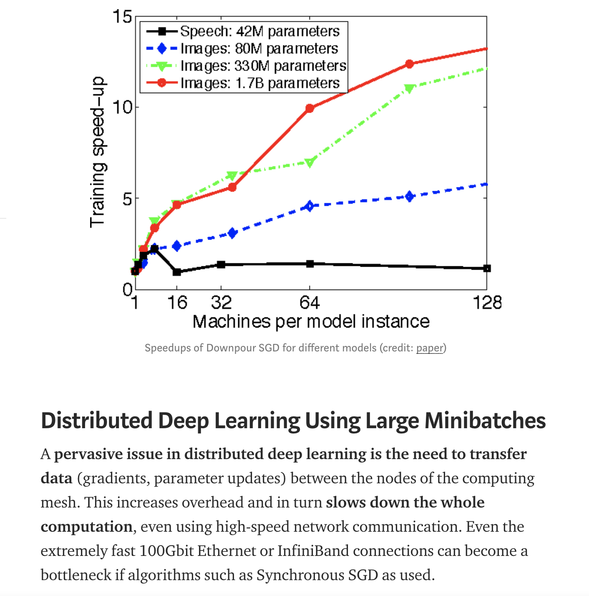
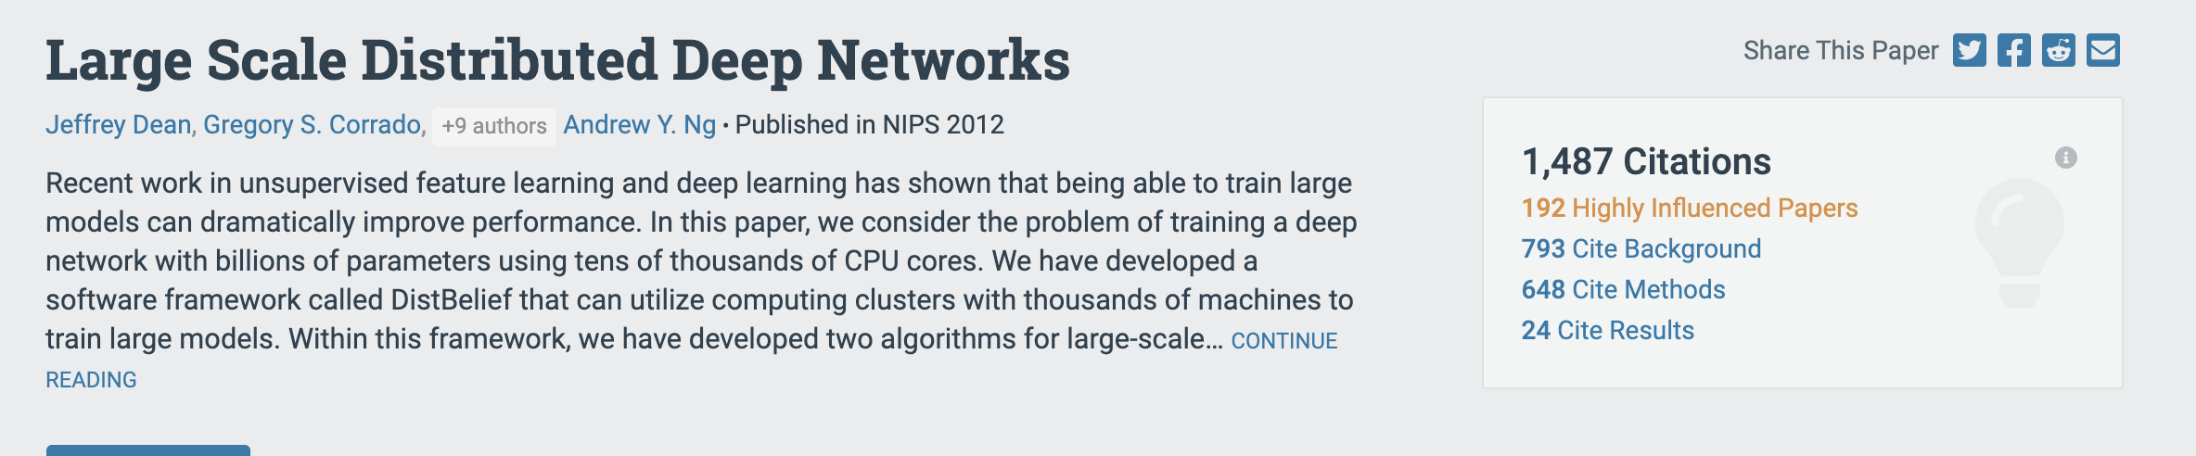
Synchronous SGD – scalability (2012)
SSGD Problem II:
The demand for bandwidth is bursty
All workers peak at the same time

Slide 41
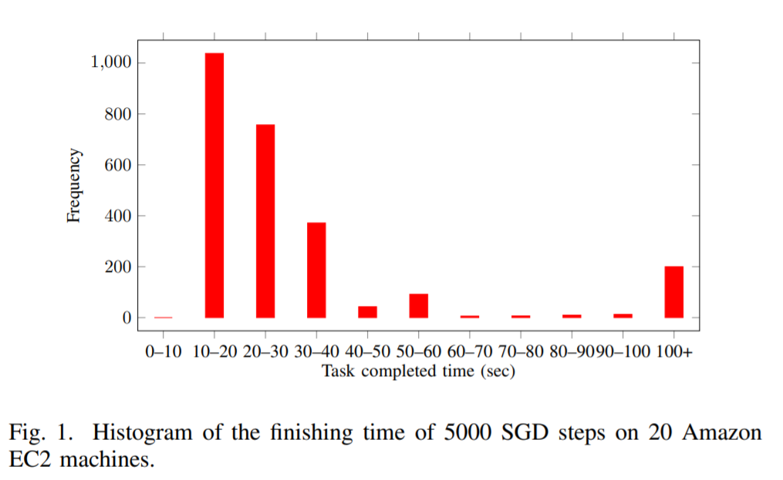

Cloud SSGD
Much cheaper to use
Easy to setup
Workers may vary in performance (over x3 slowdown!)
Taken from [1]
SSGD problem III:
Can SSGD be supported on
commodity computing platforms?
Heterogenous platforms
Non dedicated machines
Resource sharing
Unpredictable, bursty workloads
[1] “Anytime Stochastic Gradient Descent:
A Time to Hear from all the Workers” by Ferdinand et. al., 2018

Slide 42
A not so popular alternative -Asynchronous Training (ASGD)

Slide 43
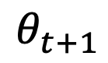
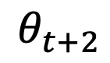
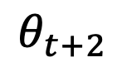
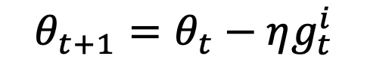
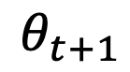
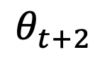
Asynchronous SGD (ASGD)
$$θ_{t+1}=θ_{t}−ηg_{t}^{i}$$
$$θ_{t}$$
$$θ_{t+1}$$
Parameter Server
$$θ_{t+2}$$
$$g_{t}^{2}$$
$$g_{t}^{3}$$
$$g_{t}^{1}$$
$$θ_{t+2}$$
$$θ_{t+1}$$
Model
Model
Model
$$θ_{t}$$
$$θ_{t}$$
$$θ_{t+1}$$
$$θ_{t+2}$$
$$θ_{t}$$
Data
Data
Data

Slide 44
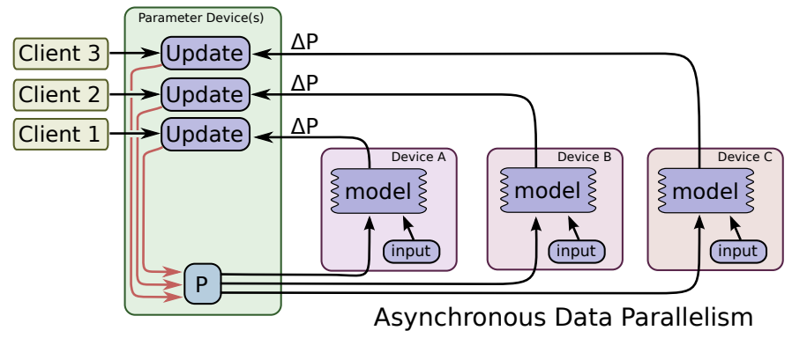
Asynchronous scheme
source: “TensorFlow: Large-Scale Machine Learning on Heterogeneous Distributed Systems”

Slide 45
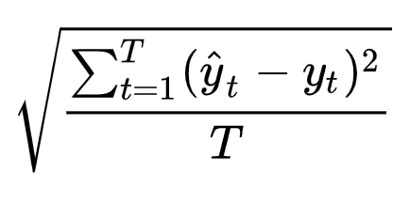
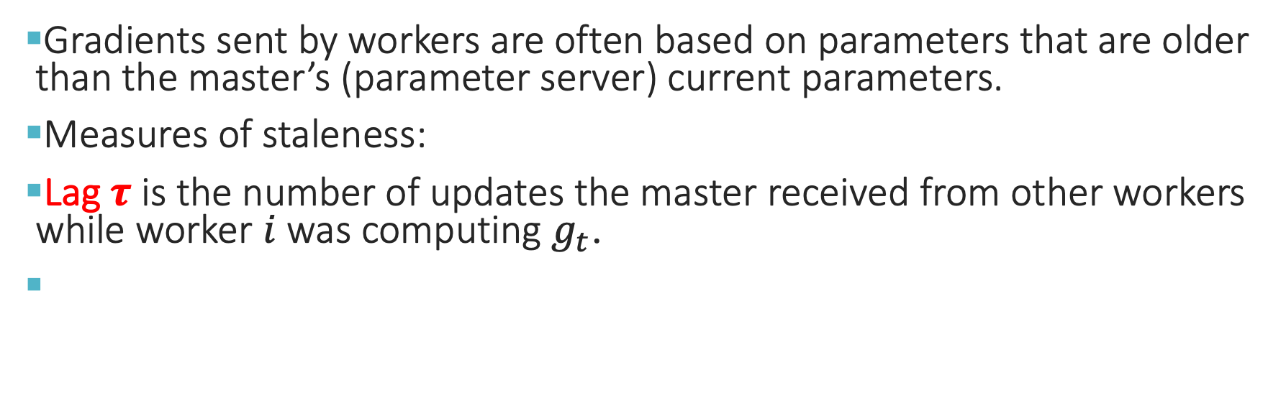
Gradient Staleness
Gradients sent by workers are often based on parameters that are older than the master’s (parameter server) current parameters.
Measures of staleness:
Lag $τ$ is the number of updates the master received from other workers while worker $i$ was computing $g_{t}$.
$$G(Gap)≜RootMeanSquareError(θ_{t}, θ_{t+τ})$$
RMSE(hat(Y),Y) =
Notes:
A more accurate way to measure the staleness is called gap.
The gap computes the staleness with respect to the actual parameters instead of the delay.
Root Mean Square Error

Slide 46
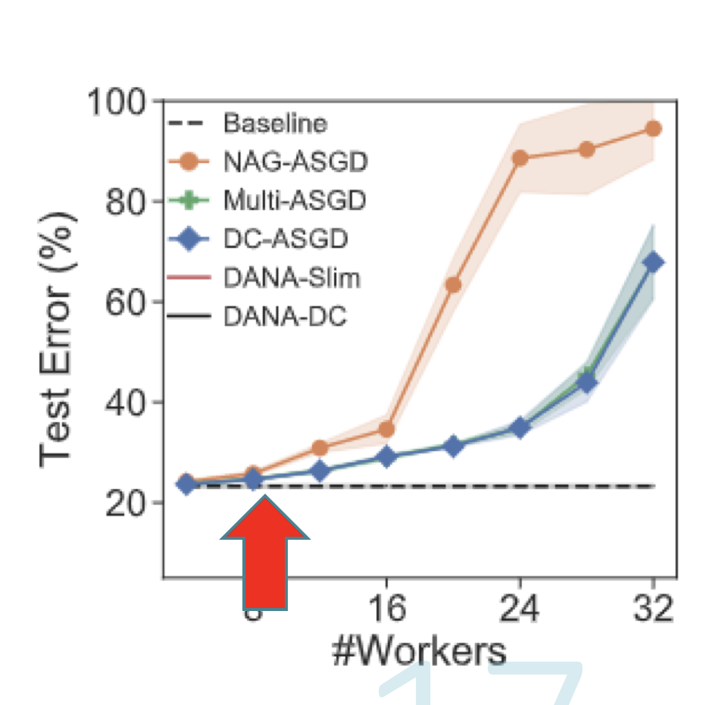
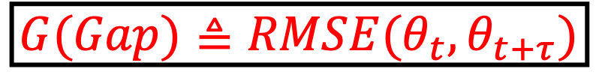
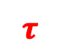
ASGD Problem I: Staleness is a HUGE Scalability Issue
Gradient staleness grows together with the number of workers, decreasing gradient relevance, and reducing accuracy
Average Lag = #workers N
$$τ$$
$$G(Gap)≜RMSE(θ_{t}, θ_{t+τ})$$
Exploration
Exploitation
Because of Staleness
ASGD scalability is
less than 10 workers
Running-time diagram
Notes:
Staleness grows with #workers

Slide 47
Momentum

Slide 48
Momentum
Momentum can be compared to a heavy ball rolling downhill that accumulates speed on its way towards the minima.
The added inertia acts both as a smoother and an accelerator, dampening oscillations and barrelling through ravines, small humps and local minima.
SGD without Momentum
SGD with Momentum
Notes:
A ball rolling downhill.
Taco!! dampening oscillations!
Ravine – canion
https://www.google.com/search?ei=aGBRXf7dF9aU-gTG9JTIAQ&q=ravine&oq=ravin&gs_l=psy-ab.1.0.0l6j0i131j0j0i131j0.7203.8109..9981...0.0..0.69.278.5......0....1..gws-wiz.......35i39j0i67.b4a0ABr1Ev8

Slide 49
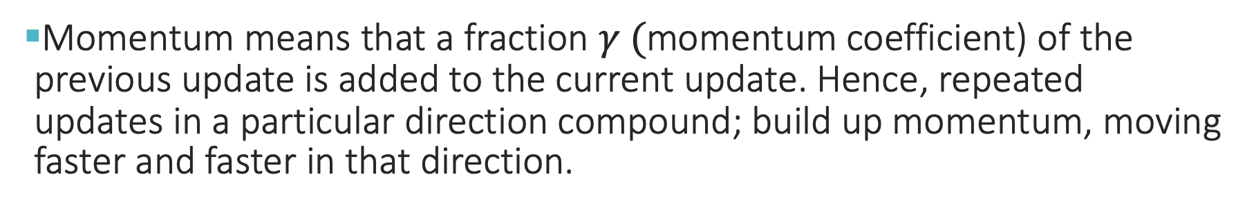
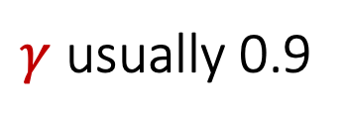
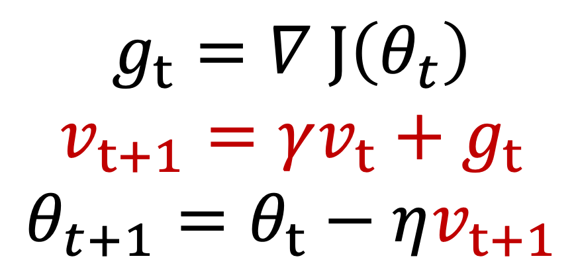
Momentum
Momentum means that a fraction $γ ($momentum coefficient) of the previous update is added to the current update. Hence, repeated updates in a particular direction compound; build up momentum, moving faster and faster in that direction.
$$g_{t}=∇ J\left(θ_{t}\right)$$
$$v_{t+1}=γv_{t}+g_{t}$$
$$θ_{t+1}=θ_{t}−ηv_{t+1}$$
$γ$ usually 0.9
Notes:
Unlike Polyak’s, we use momentum correction.
TensorFlow + PyTorch

Slide 50
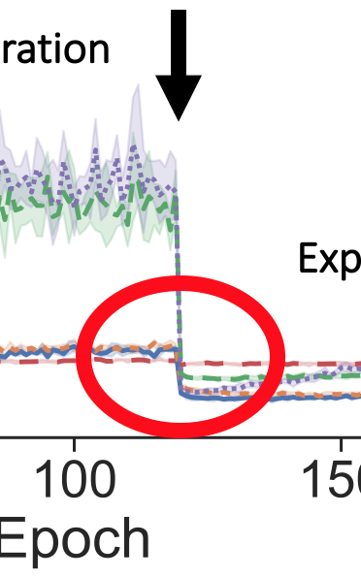
Momentum is Important!!! Convergence for CIFAR100/WideResnet with 8 Workers
Exploitation
No momentum
Exploration
Exploitation
Exploration
Exploration
Running -time diagram
Notes:
On left slide ASGD is trapped in a local minima after first drop of LR and thus does not improve accuracy after second drop of LR
broken line

Slide 51
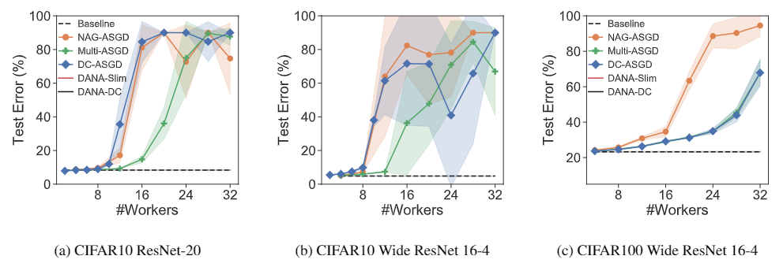
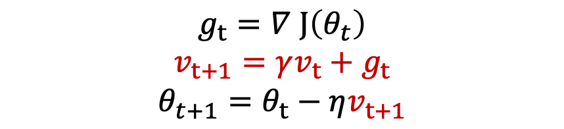
ASGD Problem II: Momentum is a HUGE challenge for ASGD
$$g_{t}=∇ J\left(θ_{t}\right)$$
$$v_{t+1}=γv_{t}+g_{t}$$
$$θ_{t+1}=θ_{t}−ηv_{t+1}$$
Accuracy: ASGD with Momentum
Bold lines show the mean over the 5 different runs.
Transparent bands show the standard deviation.
Notes:
To simplify analysis, we assume that all workers have equal computation power. This assumption can be removed without loss of generality by keeping track of worker updates and weighting them accordingly.

Slide 52
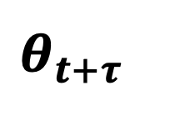

How NOT to use momentum
Momentum of [all] workers
$$θ_{t}$$
Update gradients of current worker
$$θ_{t+τ}$$

Slide 53




How to use Momentum? Nesterov’s Accelerated Gradients (NAG)
Momentum of [all] workers
$$θ_{t}$$
$$\hat{θ}$$
Update step of current worker
$$θ_{t+τ}$$

Slide 54
DANA – incorporating momentum with ASGD

Slide 55


DANA [arXiv 2019]
the master maintains a separate update vector $v^{i}$ for each worker, updated with the worker's gradients $g^{i}$
same update rule as in classic SGD with momentum
Instead of sending the master's current parameters $θ^{0}$ to the worker, DANA sends the estimated future position of the master's parameters
after $N$ updates, one for each worker
$${\hat{θ}}_{DANA} ≜θ^{0}−ηγ\sum_{i=1}^{N}{v_{prev\left(i\right)}^{i}}$$
Notice: estimation assumes round robin of worker step completion.
Easy to fix if needed when worker power is known, e.g., in a heterogeneous system
In a non-dedicated system, will always remain an estimate
Notes:
Reduces to Nesterov for N=1.

Slide 56

Accuracy - DANA
(Single worker)

Slide 57

Convergence Speed - DANA
(Single worker)
Notes:
Talk here about DANA-DC
What? What to say?
Delay Compensation

Slide 58

ImageNet Results

Slide 59

ImageNet Results

Slide 60

The Effect of DANA
Momentum greatly increases the update step - solved
gradient staleness - unsolved
Total Gap
$$G(Gap)≜RMSE(θ_{t}, θ_{t+τ})$$
DANA
Gap from Gradients
Gap from Momentum

Slide 61
Staleness mitigation

Slide 62


Staleness Penalizing
“Stale Aware”[2] the most popular method:
Divide the learning rate by the current lag $η← \frac{η}{τ+1}$
Performs well when the number of workers is small (4-8)
Fails to converge when the number of workers is large because of very small step sizes $(τ≈N−1)$
What happens when $θ_{t+τ}=θ_{t}$? Over-penalizing.
2016
[2] “staleness-aware async-sgd for distributed deep learning” by Zhang et al.

Slide 63

DANA Gap Aware [ICLR 2020]
Penalize stale gradients using the minimal number of update steps required to traverse the current distance between the parameters
MaxStepSize ~= maximal $η$ X a gradient with an average norm
[Normalized] $Gap_{t}= \frac{|\left|θ_{t+τ} −θ_{t}\right||}{η_{max} ∗E[\left|\left|∇J\left(θ\right)\right|\right|]}$

Slide 64


DANA + Gap Aware – the perfect combination
DANA – brings $θ_{t+τ}$ and $θ_{t}$ closer by estimating the master’s future position
Gap Aware – penalizes the remaining staleness
CIFAR100 WideResNet

Slide 65
CIFAR experiments - scalability
Cifar10/Resnet
Cifar10/WideResnet
Cifar100/WideResnet
Notes:
All experiments were run using the tuned hyperparameters for a single worker (except ASGD which is run with momentum = 0)

Slide 66

Gap-Aware vs. Tuning
Cifar10/R
Cifar10/WR
GA and Dana-GA are not tuned
baseline hyper-params
ASGD tuned
grid parameter search
Cifar100/WR

Slide 67

Imagenet experiments
Every worker is a machine with 8 GPUs
TTBOOK - 32 is the highest # of asynchronous workers ever reported with this framework

Slide 68
Peer-to-peer decentralized schemes

Slide 69
Decentralized scheme
One bottleneck of centralized algorithms lies on high communication cost to the parameter server.
No centralized parameter server is present in the system. Instead a peer to peer communication is used to transmit model updates between workers.

Slide 70
Model/functional decomposition

Slide 71
Domain decomposition (both SSGD+ASGD) problem: The Memory Bottleneck
Model size in accelerator – 60GB. NVIDIA’s RTX3090 and RTX6000 have 24GB RAM. V100 has 48GB.
Some models would not fit into a single accelerator
Popular solution: Model decomposition

Slide 72
Pipeline+Model Decomposition
Different workers in the distributed system perform the computations for different parts of a single network.
Compute gradients of different sets of layers on different workers ➔ “pipeline”
Compute different sets of nodes for a layer on different workers ➔ “model parallelism”
Notes:
model parallelism requires massive amount of communication.

Slide 73

Partitioning for a pipeline
Partition := one or more successive layers
Each partition is evaluated on a different accelerator
Notes:
Example : 4 partitions

Slide 74
Pipeline
P0
P1
P2
P3

Slide 75
Example: (Naïve) Backpropagation
P0
P1
P2
P3
MB1 (FWD)
MB1 (BWD)
Naïve, sequential, no parallelism

Slide 76


Microsoft Research

Slide 77



SOSP 2019

Slide 78
Issues with parallel pipeline (example) Partition the model to L=4 Partitions (pipeline of length 4):
P0
P1
P2
P3

Slide 79
On minibatch arrival:
P0
P1
P2
P3
MINI BATCH SIZE = 128

Slide 80
SPLIT to M=4 microbatches
P0
P1
P2
P3
Microbatch 1 size = 32
Microbatch 2 size = 32
Microbatch 3 size = 32
Microbatch 4 size = 32

Slide 81
STEP 0
$$W_{0}^{0}$$
𝑊_0^0
$$W_{0}^{1}$$
𝑊_0^1
$$W_{0}^{2}$$
𝑊_0^2
$$W_{0}^{3}$$
𝑊_0^3
MB1 (FWD)
Fwd queue
MB2
MB3
MB4

Slide 82
STEP 1
$$W_{0}^{0}$$
𝑊_0^0
$$W_{0}^{1}$$
𝑊_0^1
$$W_{0}^{2}$$
𝑊_0^2
$$W_{0}^{3}$$
𝑊_0^3
MB2 (FWD)
MB1 (FWD)
Fwd queue
MB3
MB4

Slide 83
STEP 2
$$W_{0}^{0}$$
𝑊_0^0
$$W_{0}^{1}$$
𝑊_0^1
$$W_{0}^{2}$$
𝑊_0^2
$$W_{0}^{3}$$
𝑊_0^3
MB3 (FWD)
MB2 (FWD)
MB1 (FWD)
Fwd queue
MB4

Slide 84
STEP 3
Fwd | bwd | staleness
0 | 0 | 0
$$W_{0}^{0}$$
𝑊_0^0
$$W_{0}^{1}$$
𝑊_0^1
$$W_{0}^{2}$$
𝑊_0^2
$$W_{0}^{3}$$
𝑊_0^3
MB4 (FWD)
MB3 (FWD)
MB2 (FWD)
MB1 (FWD+BWD)
Fwd queue

Slide 85
STEP 4
Fwd | bwd | staleness
0 | 0 | 0
Fwd | bwd | staleness
1 | 1 | 0
$$W_{0}^{0}$$
𝑊_0^0
$$W_{0}^{1}$$
𝑊_0^1
$$W_{0}^{2}$$
𝑊_0^2
$$W_{1}^{3}$$
𝑊_1^3
MB4 (FWD)
MB1 (BWD)
MB2 (FWD+BWD)
Fwd queue
MB3
Notes:
For the last partition –
FWD+BWD happen in parallel because we don’t do recomputation.

Slide 86
STEP 5
Fwd | bwd | staleness
0 | 0 | 0
Fwd | bwd | staleness
0 | 1 | 1
$$W_{0}^{0}$$
𝑊_0^0
$$W_{0}^{1}$$
𝑊_0^1
$$W_{1}^{2}$$
𝑊_1^2
$$W_{2}^{3}$$
𝑊_2^3
MB1 (BWD)
MB2 (BWD)
Fwd queue
MB3
MB4
Notes:
NOTE:
The policy here is BWD ASAP,
So in partition(2) we prefer to do backward,
In this case, PipeDream whould prefer

Slide 87
STEP 6
Fwd | bwd | staleness
0 | 0 | 0
Fwd | bwd | staleness
0 | 1 | 1
$$W_{0}^{0}$$
𝑊_0^0
$$W_{1}^{1}$$
𝑊_1^1
$$W_{2}^{2}$$
𝑊_2^2
$$W_{2}^{3}$$
𝑊_2^3
MB1 (BWD)
MB2 (BWD)
MB3 (FWD)
Fwd queue
MB4

Slide 88
STEP 7
Fwd | bwd | staleness
0 | 1 | 1
Fwd | bwd | staleness
2 | 2 | 0
$$W_{1}^{0}$$
𝑊_1^0
$$W_{2}^{1}$$
𝑊_2^1
$$W_{2}^{2}$$
𝑊_2^2
$$W_{2}^{3}$$
𝑊_2^3
MB2 (BWD)
MB4 (FWD)
MB3 (FWD+BWD)

Slide 89
STEP 7
Fwd | bwd | staleness
2 | 2 | 0
Fwd | bwd | staleness
3 | 3 | 0
$$W_{2}^{0}$$
𝑊_2^0
$$W_{2}^{1}$$
𝑊_2^1
$$W_{2}^{2}$$
𝑊_2^2
$$W_{3}^{3}$$
𝑊_3^3
MB3 (BWD)
MB4 (FWD+BWD)

Slide 90
STEP 8
Fwd | bwd | staleness
0 | 2 | 2
Fwd | bwd | staleness
2 | 3 | 1
$$W_{2}^{0}$$
𝑊_2^0
$$W_{2}^{1}$$
𝑊_2^1
$$W_{3}^{2}$$
𝑊_3^2
$$W_{4}^{3}$$
𝑊_4^3
MB3 (BWD)
MB4 (BWD)

Slide 91
STEP 9
Fwd | bwd | staleness
0 | 2 | 2
Fwd | bwd | staleness
0 | 3 | 3
$$W_{2}^{0}$$
𝑊_2^0
$$W_{3}^{1}$$
𝑊_3^1
$$W_{4}^{2}$$
𝑊_4^2
$$W_{4}^{3}$$
𝑊_4^3
MB3 (BWD)
MB4 (BWD)

Slide 92
STEP 10
Fwd | bwd | staleness
0 | 3 | 3
$$W_{3}^{0}$$
𝑊_3^0
$$W_{4}^{1}$$
𝑊_4^1
$$W_{4}^{2}$$
𝑊_4^2
$$W_{4}^{3}$$
𝑊_4^3
MB4 (BWD)

Slide 93
STEP 10 -> minibatch done
$$W_{4}^{0}$$
𝑊_4^0
$$W_{4}^{1}$$
𝑊_4^1
$$W_{4}^{2}$$
𝑊_4^2
$$W_{4}^{3}$$
𝑊_4^3

Slide 94
NOW – start a new minibatch (and so on)
$$W_{4}^{0}$$
𝑊_4^0
$$W_{4}^{1}$$
𝑊_4^1
$$W_{4}^{2}$$
𝑊_4^2
$$W_{4}^{3}$$
𝑊_4^3
MINI BATCH SIZE = 128
Micro batch 1 size = 32
Micro batch 2 size = 32
Micro batch 3 size = 32
Micro batch 4 size = 32

